Slide 1


DEPARTMENT OF ELECTRONICS AND COMMUNICATION
ENGINEERING
III YEAR (2022-2026)

Slide 2
TECHNOLOGICAL SOLUTION FOR SAFE DISPOSAL OF MENSTRUAL WASTE
TEAM MEMBERS :
SWETHA M (927622BEC228)
SWETHA M (927622BEC229)
THANISHKA K (927622BEC230)
SUBISHA P (927622BEC211)
GUIDED BY:
MS.S.VASUKI

Slide 3
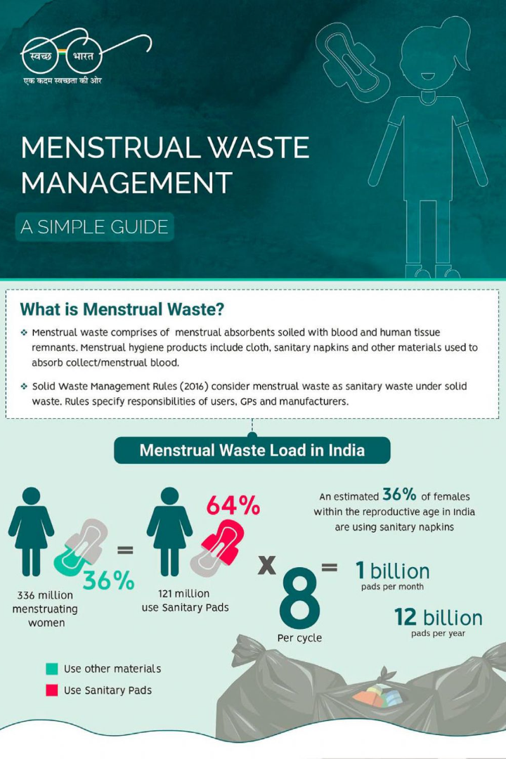
INTRODUCTION
In this presentation, we will explore the challenges and drawbacks of current menstrual waste disposal methods, and introduce a futuristic technological solution to address this pressing issue.

Slide 4
As per our survey, The results shows that around 40.4% of the participants were not aware of the device incinerator. Though 59.6% of the respondents were aware of the device, only 17.8% of them utilized it.
The solution to the challenges associated with soiled napkin disposal would be an effective, low-cost, and user-friendly smart incinerator. This technology has the potential to reduce the quantity of bio waste that ends up in landfills.

Slide 5
OVERVIEW OF MENSRTUAL WASTE AND ITS ENVIRONMENTAL IMPACT
Menstrual waste primarily consists of used sanitary products like pads, tampons, and menstrual cups, which are typically disposed of after each use.
Most disposable menstrual products are made from a combination of plastic, cotton, and synthetic materials, often containing superabsorbent polymers and adhesives.
These materials are not biodegradable and take hundreds of years to break down, leading to significant environmental concerns.

Slide 6
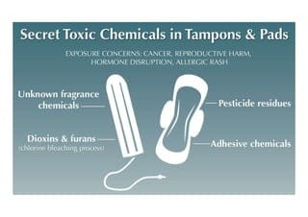
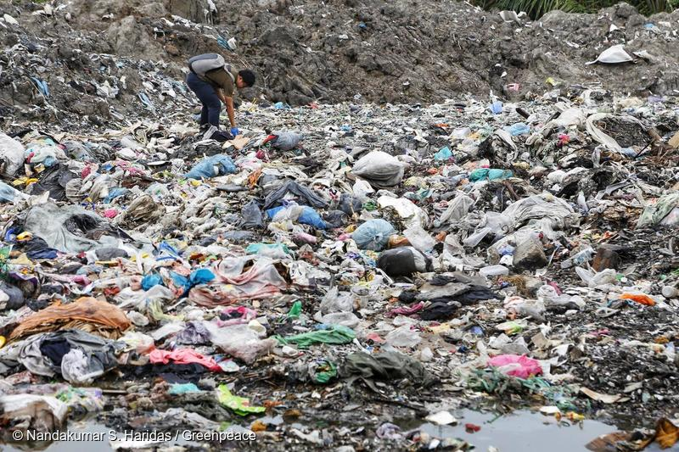
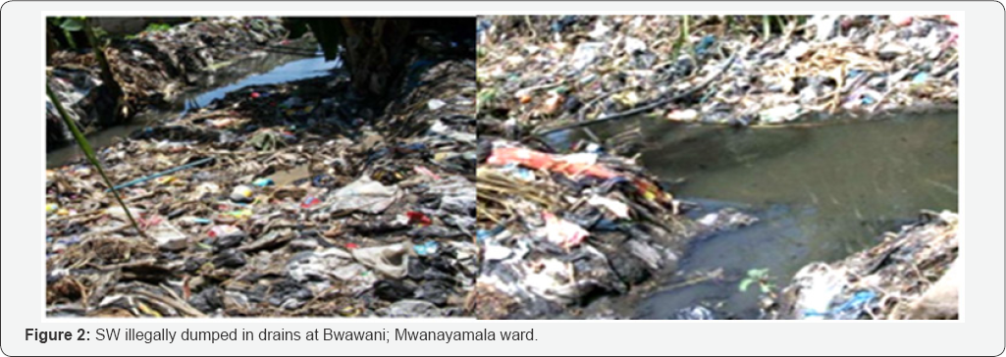
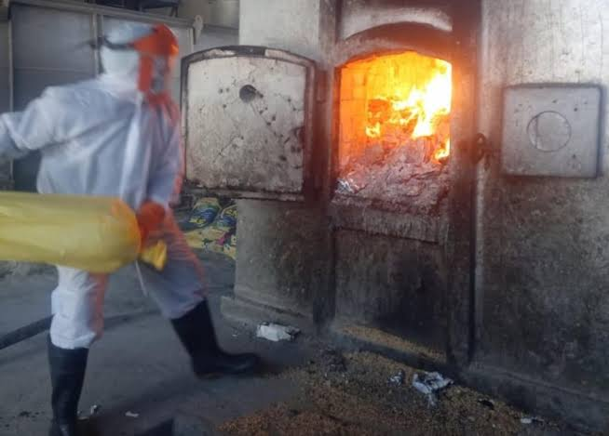
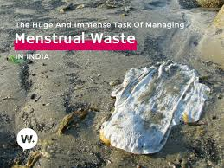
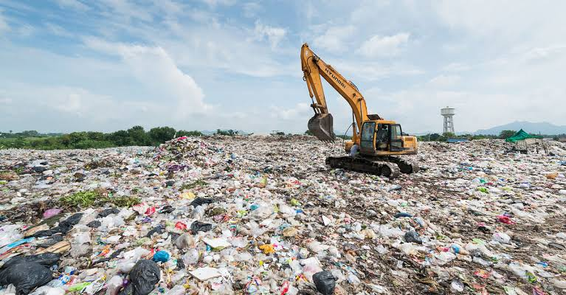
ENVIRONMENTAL IMPACTS
Plastic Pollution
Waste Accumulation
Chemical Pollution
Impact on Waterways
Incineration Issues
Landfill Overload

Slide 7
IMPORTANCE OF SAFE DISPOSAL METHODS
Public Health
Environmental Protection
Waste Management Efficiency
Social and Cultural Dignity
Compliance with Regulations
Supporting Sustainable Development Goals

Slide 8
CHALLENGES OF MENSTRUAL DISPOSAL
Lack of Awareness and Education
Inadequate Infrastructure
Environmental Concerns
Health Risks
Social and Cultural Barriers
Economic Challenges
Regulatory and Policy Gaps
Technological Limitations
Logistical Challenges in Rural Areas
Waste Segregation Issues

Slide 9
CURRENT METHODS AND THEIR LIMITATIONS
1.LANDFILLING:
Non-Biodegradability
Landfill overload
Leaching of Chemicals
2.INCINERATION:
Air Pollution
High cost
Limited Accessibility
3.FLUSHING:
Sewage Blockages
Marine Pollution

Slide 10
4.OPEN BURNING
Health Risks
Environmental Damage
Incomplete Combustion
5.COMPOSTING
Limited Applicability
Health Concerns
6.BURIAL
Soil Contamination
Space Constraints
Wildlife Risks
7.USE OF SANITARY DISPOSAL BINS
Hygiene Issues
Waste Management Challenges
Limited Coverage

Slide 11
IMPLEMENTATION AND SCALABILITY
ARDUINO NANO
CONTROLLER
POWER SUPPLY
LCD DISPLAY
IR SENSOR
BUZZER
GAS SENSOR
RELAY

Slide 12
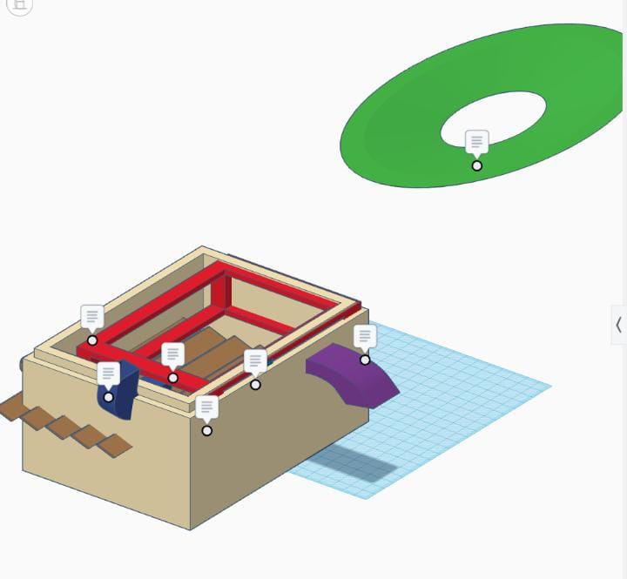
3D MODEL
LINK: 3D design Glorious Krunk - Tinkercad

Slide 13
HARDWARE REQUIRED
Power Supply
Arduino Nano
IR sensor
GAS sensor
LCD Display
Buzzer
Relay
SOFTWARE REQUIRED
Arduino IDE
Embedded C
Proteus testing tool

Slide 14
PROGRAM USING EMBEDDED C
int buzzer = 13;
void setup()
{
pinMode(buzzer, OUTPUT);
}
void loop()
{
digitalWrite(buzzer, HIGH);
delay(1000);
digitalWrite(buzzer, LOW);
delay(1000);
}

Slide 15
ADVANTAGES OVER EXISTING METHODS
Uses Gas(LPG) instead of electricity
Produce fewer emissions
Energy efficient
Cost effective
Reduces the waste into ash completely
No secondary pollution
Portable

Slide 16
FUTURE DEVELOPMENT AND UPGRADES
Requires space and advanced devices due to flame generation
Innovative ideas: sanitizing sprayer, air pollution control devices
Key improvements: Rapid cool exhaust gases (<200°C) to prevent dioxin reformation .Maintain optimal oxygen levels for complete combustion and reduced dioxin formation

Slide 17
SOCIAL IMPACT AND AWARENESS
Hygiene
Environmental Protection
Awareness and Education
Dignity
Accessibility

Slide 18
TESTING RESULTS
The sample sketch above is a blink which is also applicable for LEDs. The output is the turning on and off of the buzzer every other second. The picture below shows the setup of your module and Arduino.

Slide 19
CONCLUSION
In the early days, women utilized various absorbents for coping with menstruation. The available absorbents made menstruation comfortable. However, the unaffordability and unavailability of the napkins continue. Even though most people purchase and utilize sanitary napkins, the disposal mechanisms are not efficient. Localized waste management would be a better solution instead of handling it in a centralized manner. Hence, government organizations could install incinerators in every community.

Slide 20
REFERENCE
Y.-C. Chang et al. An integrated approach for operational knowledge acquisition of refuse incinerators Expert Syst. Appl. (2007)
K. Chen et al. Bagging based ensemble learning approaches for modelling the emission of PCDD/Fs from municipal solid waste incinerators Chemosphere (2021)
T. Buckley Menstruation and the power of Yurok women: methods in cultural reconstruction
Am. Ethnol. (1982) J. Delaney The curse: a cultural history of menstruation (1988) L. Freidenfelds The modern period: menstruation in twentieth-century America (2009)

Slide 21
THANK YOU

